Slide 1
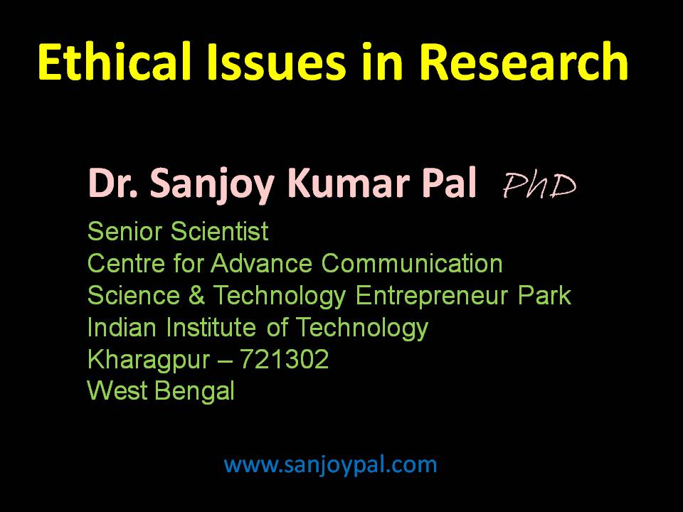

Slide 2
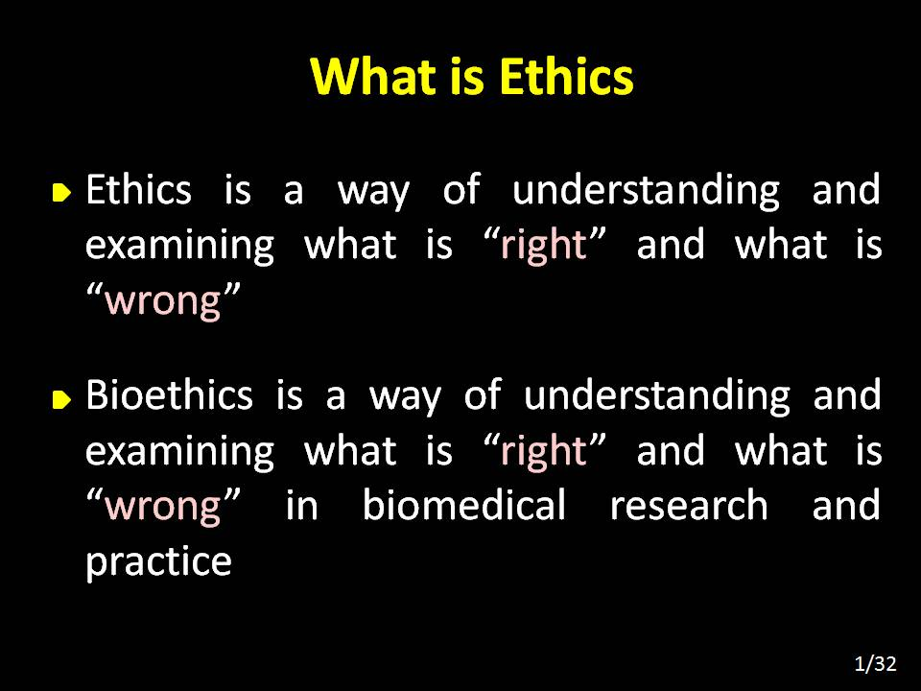

Slide 3


Slide 4
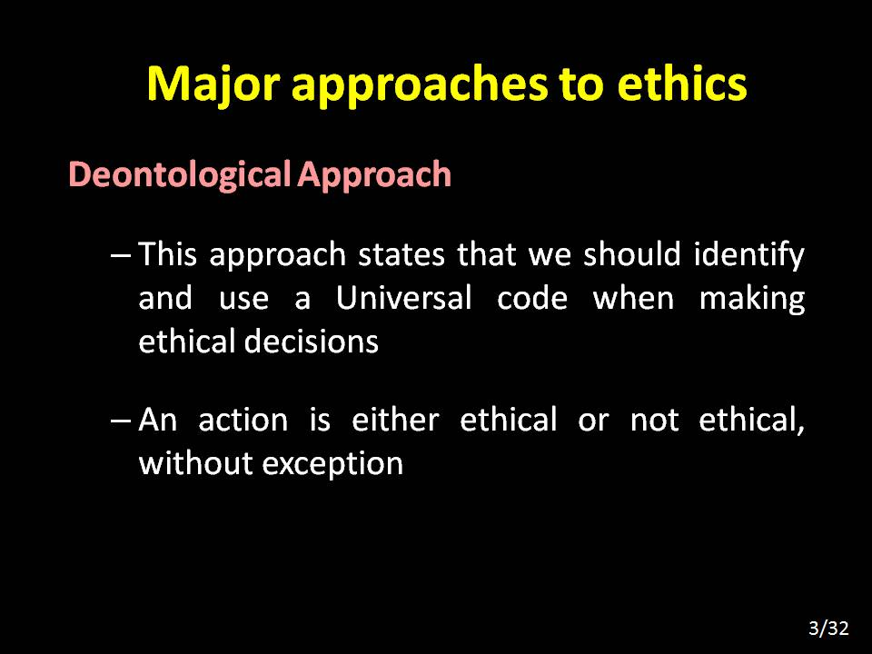

Slide 5


Slide 6
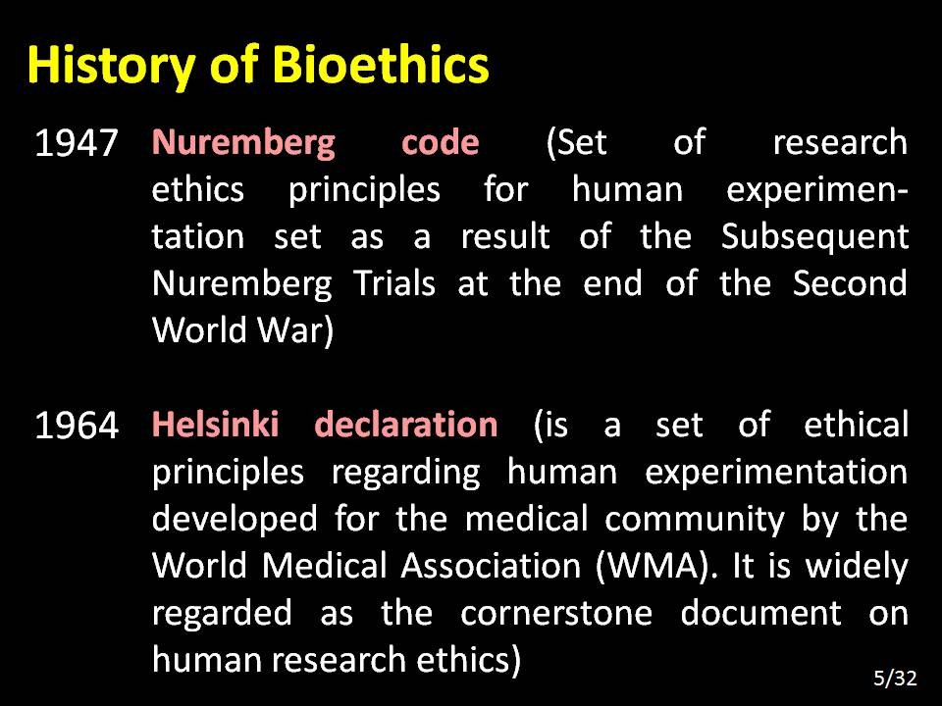

Slide 7
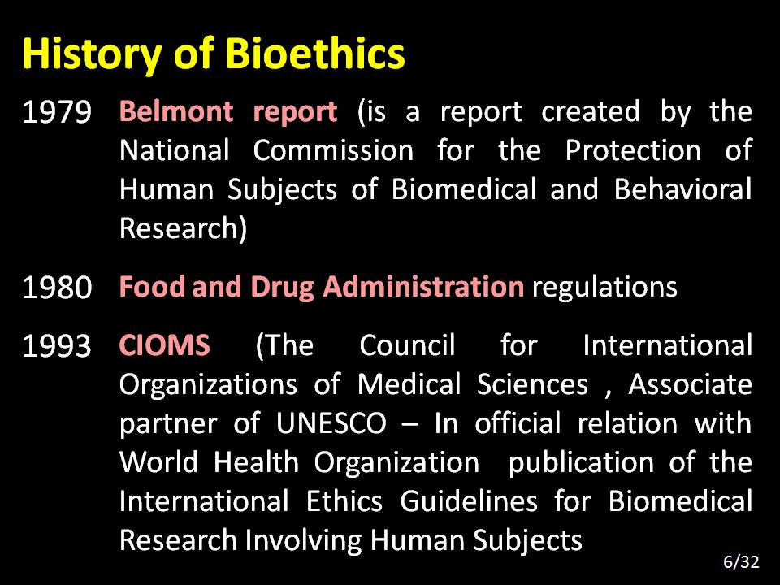

Slide 8
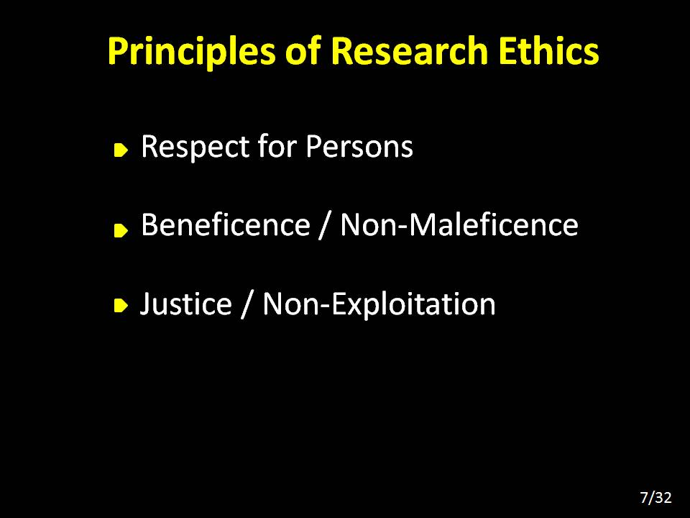

Slide 9
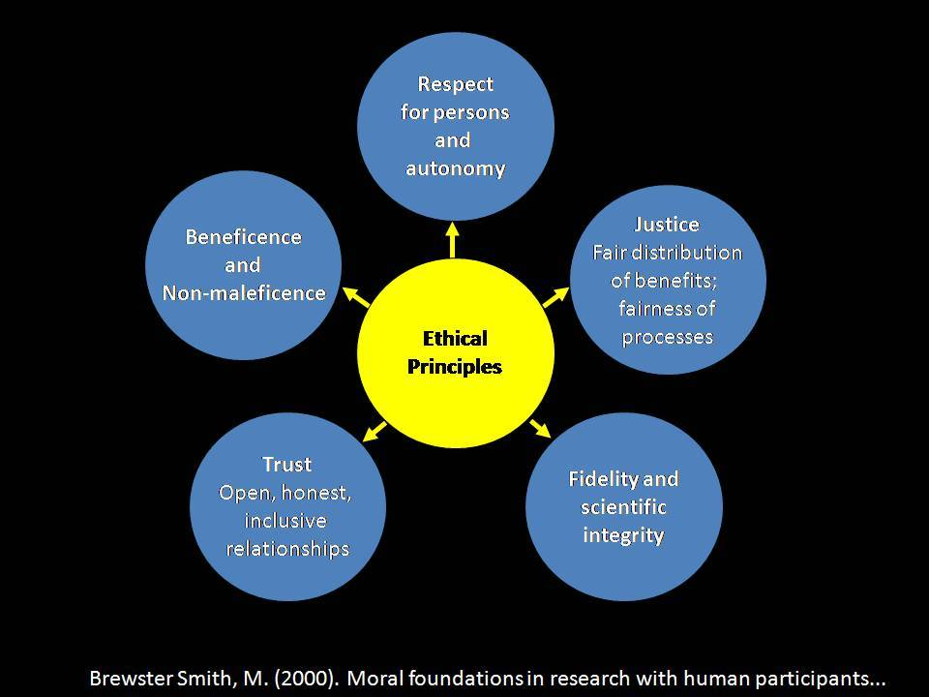

Slide 10
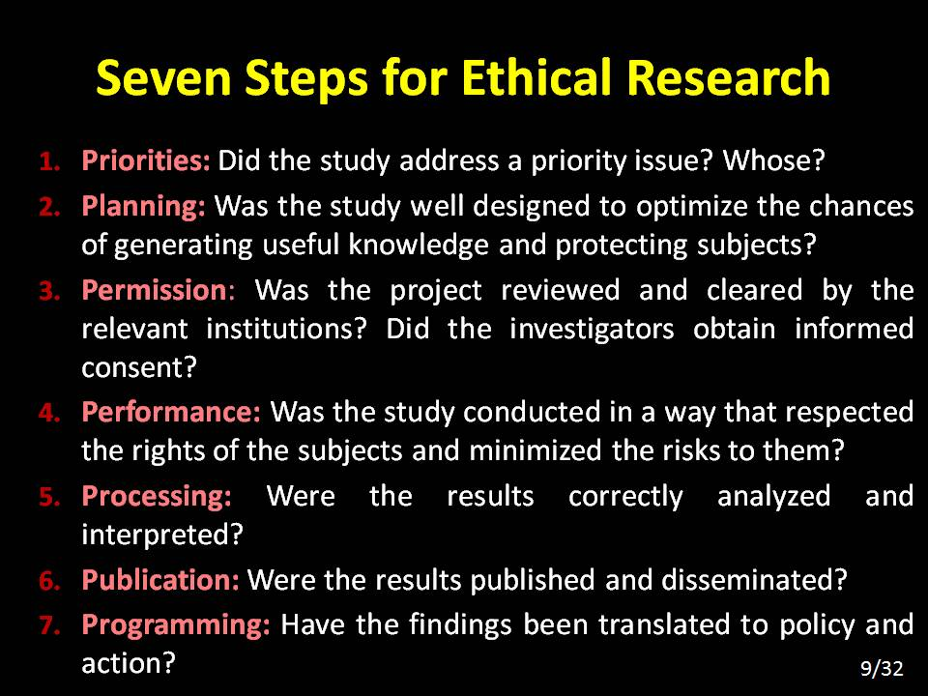

Slide 11
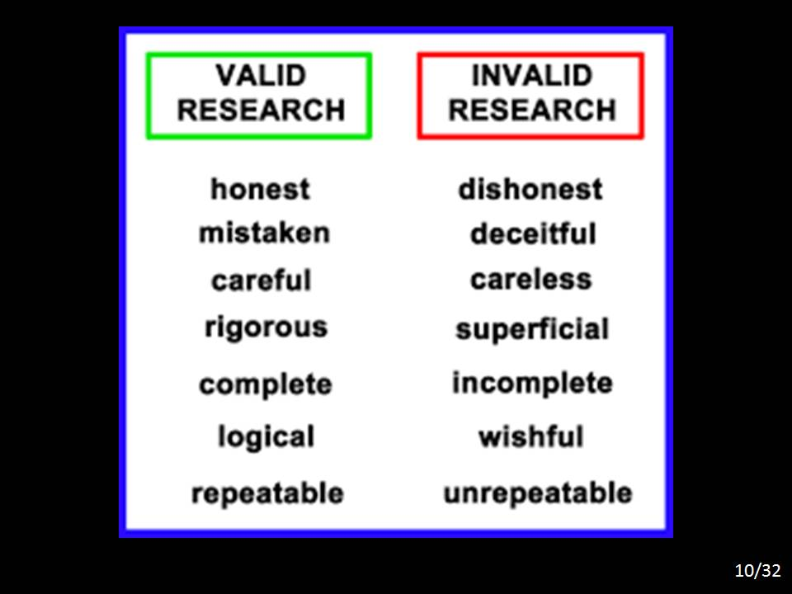

Slide 12

Institutional Review Board / Ethics committee
Research Idea
(Pre & Clinical)
Clearance of Project
Funding Agency
- Governmental
- Private Company
- International
Future Studies
Market / Use
Recommendations
Flow chart
Review & Approval of Research Project
Publication of Report, papers
(Conflict of interest)
Analysis of Data after project completion
Project Initiation
Project Monitoring
11/32

Slide 13
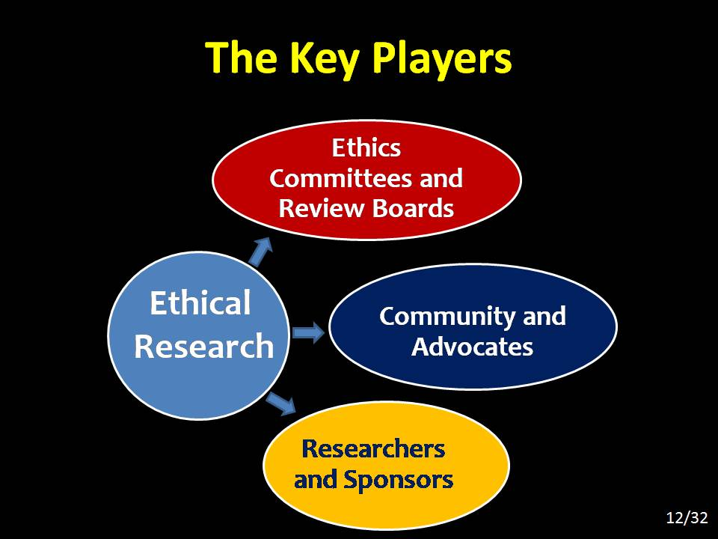

Slide 14
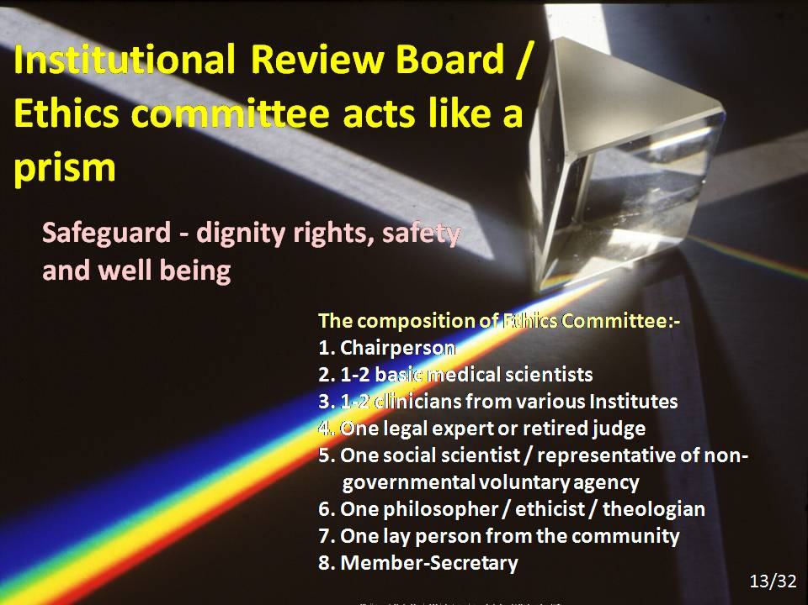

Slide 15
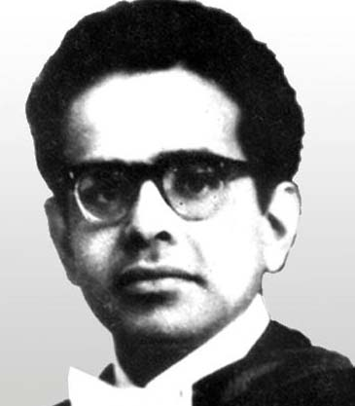
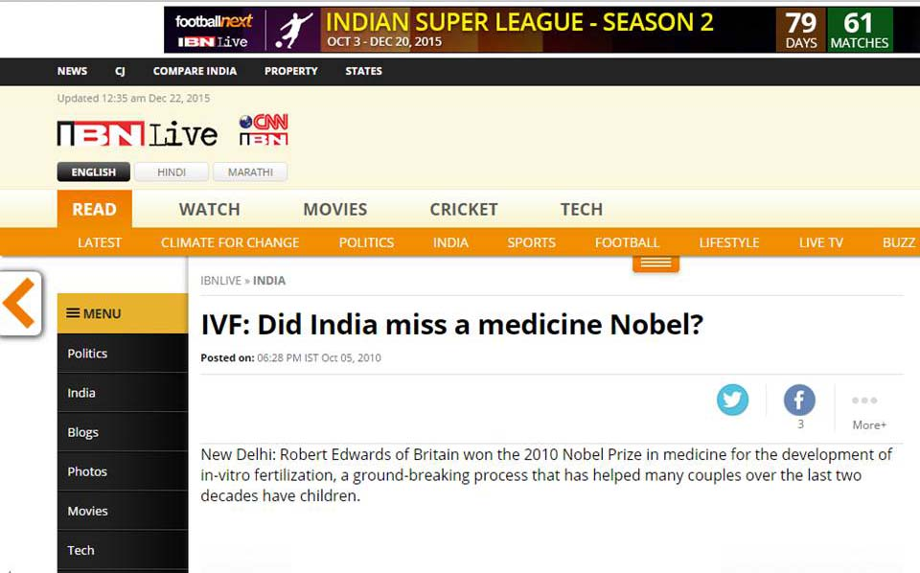
New Delhi: Robert Edwards of Britain won the 2010 Nobel Prize in medicine for the development of in-vitro fertilization, a ground-breaking process that has helped many couples over the last two decades have children. While Edwards was working towards his dream - creating the worlds first in vitro fertilized or test tube baby - a physician in India was working on the same subject but the odds were piled heavily against him.
Bengali doctor Subhash Mukhopadhyay was two months late in announcing the birth of Durga or Kanupriya Agarwal – India’s first test tube baby created by him on October 3, 1978.While Edwards, professor emeritus at University of Cambridge, was lauded for his efforts, Mukhopadhyay was fighting a hostile state government that rubbished his findings.
14/32

Slide 16
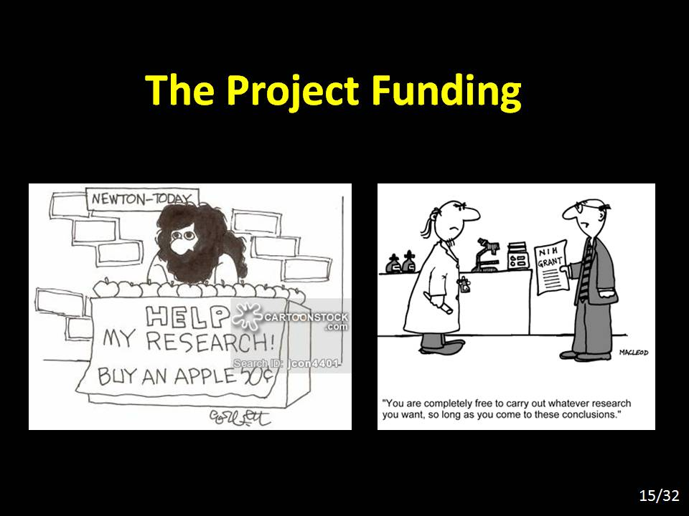

Slide 17


Slide 18
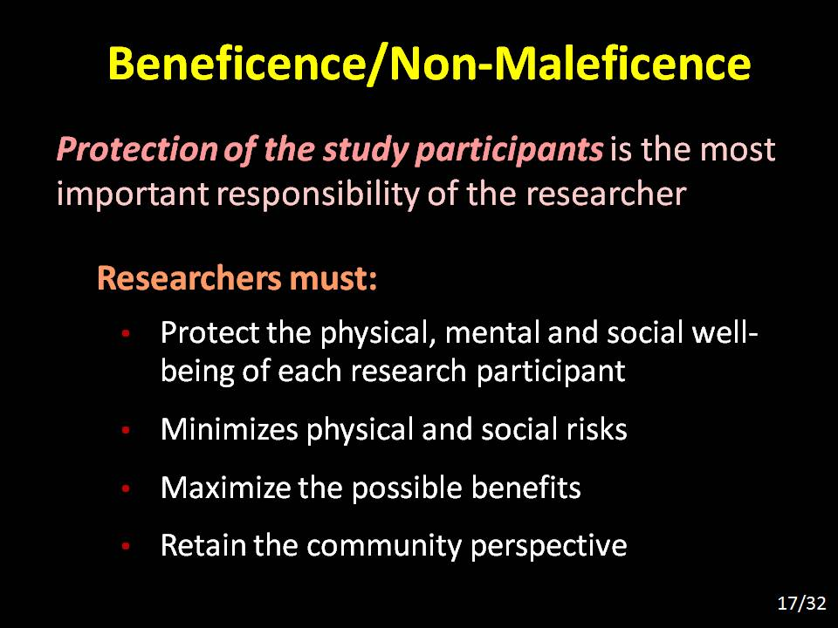

Slide 19


Slide 20
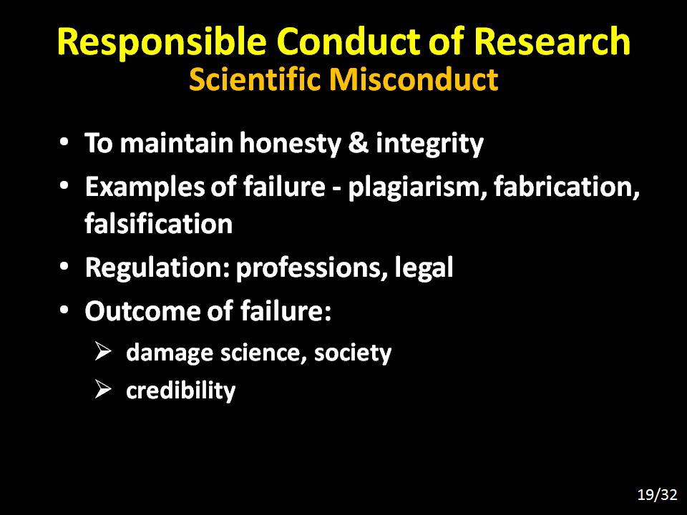

Slide 21
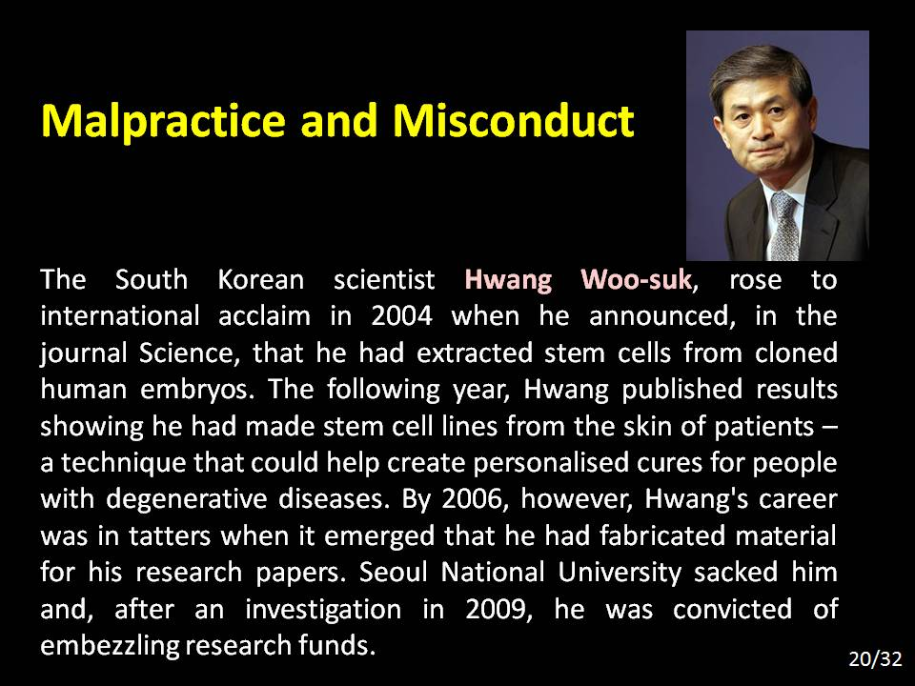

Slide 22
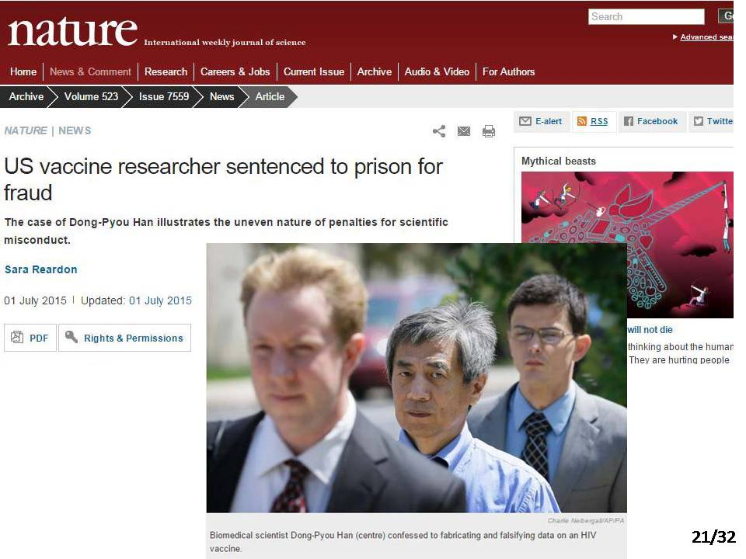

Slide 23
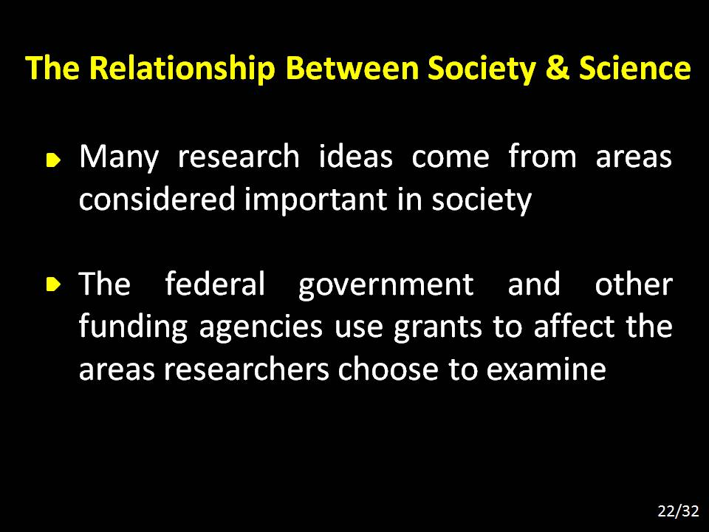

Slide 24
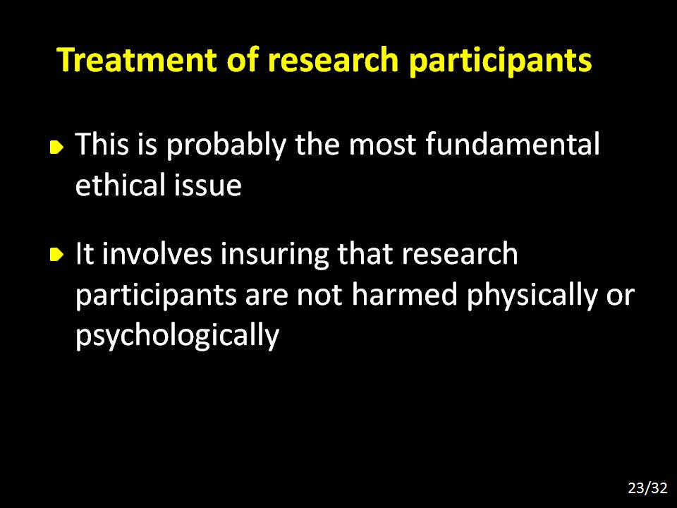

Slide 25
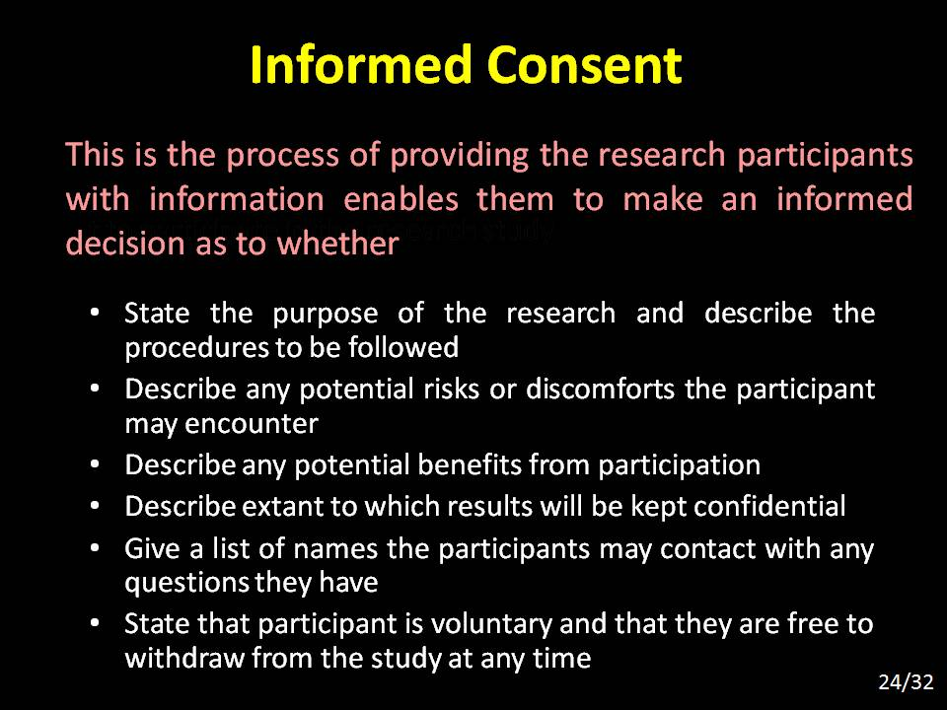

Slide 26
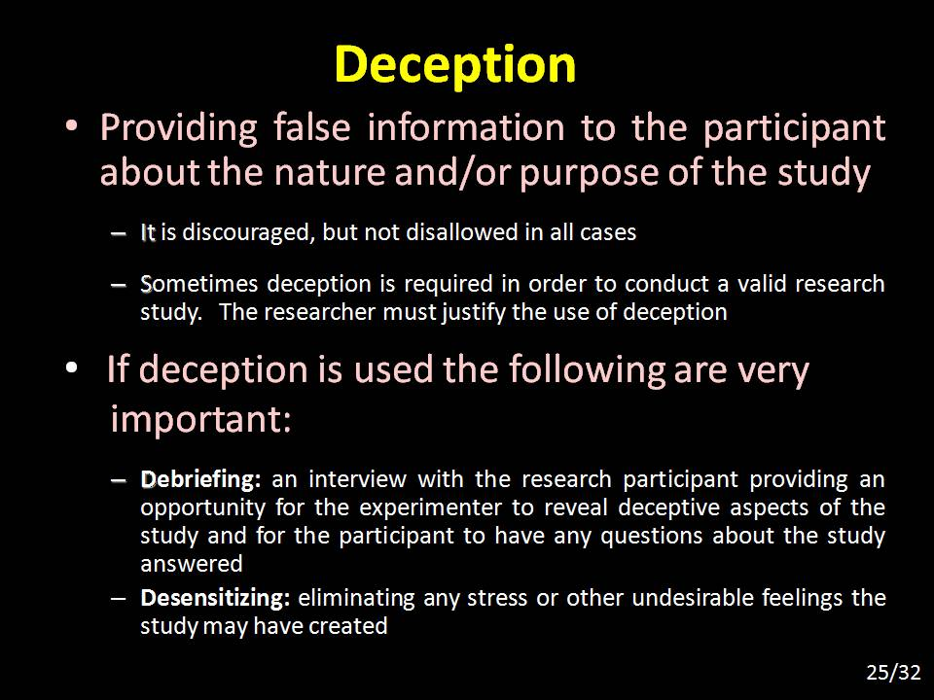

Slide 27
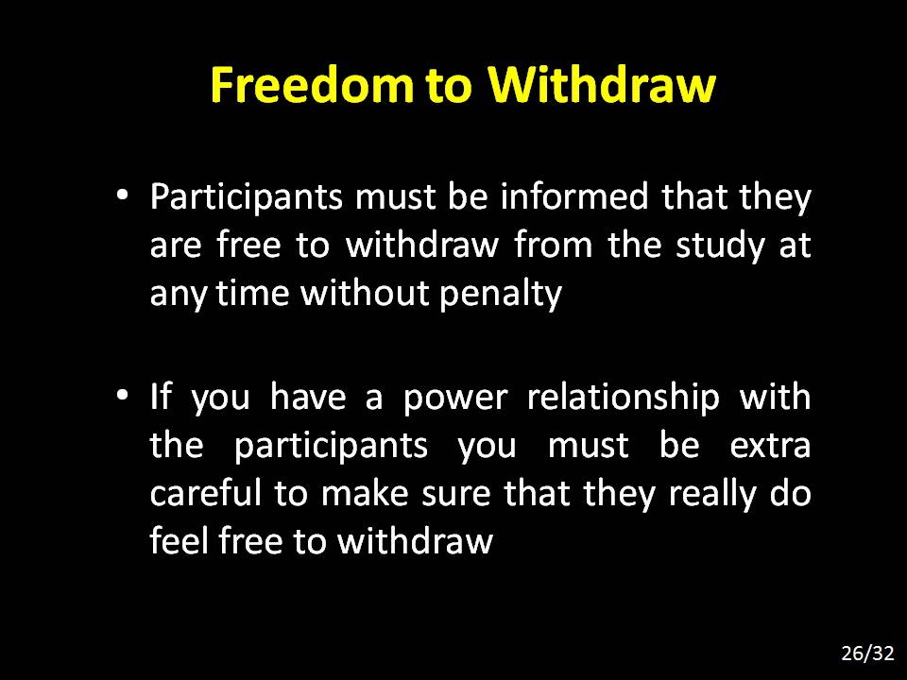

Slide 28


Slide 29


Slide 30

Can land you in trouble

Slide 31
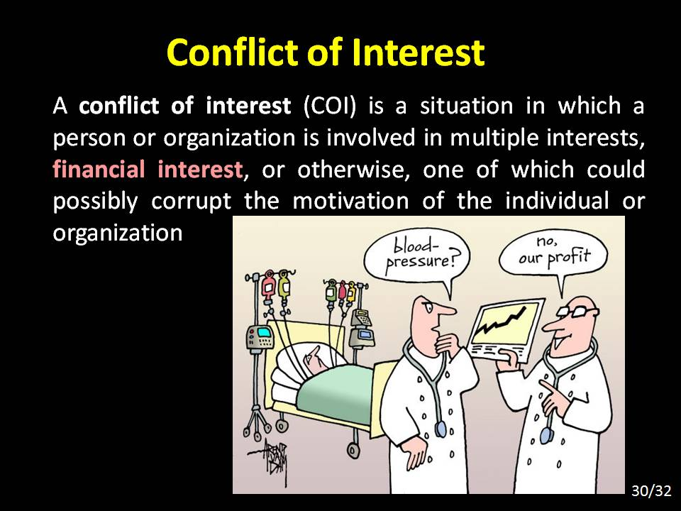

Slide 32


Slide 33

Thank You

Slide 34
